Slide 1
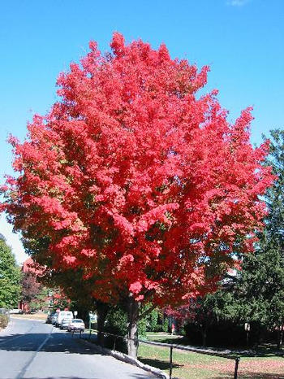
Trees

Slide 2
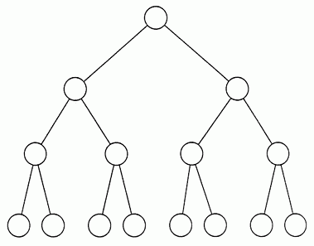
Nonlinear Containers
Containers we have studied so far are linear:
To represent nonlinear (hierarchal) data we use trees.
root
edge
node
edge
node
edge
leaf

Slide 3
Tree Terminology
root
parent node
child node
leaf
(no children)
sub-tree
Binary Tree: two child nodes
Oct-tree: eight child nodes, etc.
Huffman Tree: binary tree of codes of characters that might appear in the encoded message

Slide 4
Types of Trees
Complete Tree
Full Tree
Incomplete Tree

Slide 5
Binary Tree Node
Root Node
data
left
right
data
data
left
right
left
right
Left Child Node
Right Child Node

Slide 6
TreeNode Structure
template<typename DATA_TYPE> struct TreeNode
{
TreeNode(const DATA_TYPE& value, TreeNode* left = NULL, TreeNode* right = NULL)
{
Value = value;
Left = left;
Right = right;
}
DATA_TYPE Value;
TreeNode* Left;
TreeNode* Right;
bool IsLeaf() const
{
return Left == NULL && Right == NULL;
}
};

Slide 7
Tree Tips
1) Tree is given by a pointer to its root
TreeNode<string>* root;
2) Tree nodes (including root) need to be allocated dynamically on heap:
TreeNode<string>* node =
new TreeNode<string>(“test”);
3) Unneeded tree nodes should be deleted.

Slide 8
Recursive Tree Traversal
// Base case: choose isLeaf or is NULL
If treeNode is null then
return
Else
// Recursion
for each childNode
// Recursively traverse child node’s sub-tree
traverse childNode
end for
End if

Slide 9
Binary Tree Preorder Traversal
Preorder: process root node, traverse left sub-tree, traverse right sub-tree
Node processing order: a b d e c
a
b
c
d
e

Slide 10
Binary Tree Inorder Traversal
Inorder: traverse left sub-tree, process root node, traverse right sub-tree
Node processing order: d b e a c
a
b
c
d
e

Slide 11
Binary Tree Postorder Traversal
Postorder: traverse left sub-tree, traverse right sub-tree, process root node
Node processing order: d e b c a
a
b
c
d
e

Slide 12
Exercise: Expression Tree
Task: Build a tree to represent and evaluate an arithmetic expression.
What kind of tree? Binary
Why Binary? Because arithmetic operations require two operands, e.g. a+b
Cannot be incomplete! Each node must either be a leaf or have exactly two children

Slide 13
Arithmetic Expression Tree
10+3*4/2-1
Nodes: operations +,-,*,/
Leafs: operands
-
+
nodes
1
10
*
leafs
3
/
4
2

Slide 14
Tree Construction Algorithm
For simplicity assume single-digit operands, no parenthesis and well-formed expression e.g.:1+5*3-4/2
Set treeRoot = NULL;
Set currentNode = treeRoot;
For each character in the expression
  If you find characters ‘0’..’9’ then
    Create newLeaf node (using new operator), set its value to ‘0’..’9’
    If the currentNode == NULL then
    treeRoot = currentNode = newLeaf;
    else
    currentNode->Right = newLeaf;
  If you find ‘+’ or ‘-’ (or ‘*’ or ’/’ and currentNode->Right == NULL) then
    Create newRoot node, set its value the operation found
    Set newRoot->Left = treeRoot;
    Set treeRoot = newRoot;
    Set currentNode = newRoot;
  If you find ‘*’ or ‘/’ then
    Create newChild node, set its value value the operation found
    Set newChild->Left = currentNode->Right;
    Set currentNode ->Right = newChild;
    Set currentNode = newChild;

Slide 15
Tips
Pick a test expression and build a tree on paper;
Build a tree in software, add root to debug Watch window, expand all nodes and compare tree to the one on paper;
TreeNode<char>* root;
Create recursive ValueOf() function to evaluate the expression.

Slide 16
Recursive ValueOf() Function
Base case: if node is leaf then return the number stored in the node.
Tip: you can convert character ‘9’ to integer 9 by subtracting ‘0’ from character, e.g.
value = node->Value - ‘0’;
Recursion: value = ValueOf(node->Left) op ValueOf(node->Right);
Return value: what type should it be?
op is +, -, *, or /
Left
Right

Slide 17
Assignment
Finish the lab.
Extra credit: 25% for multi-digit numbers; 25% for parenthesis.
Read chapter 8.
Prepare for extra credit questions.

